Slide 1
Extracting Features
Normalization
Fast Fourier Transforms
Discrete Wavelength Transforms
Coordinate Transformations (for geometric data vs. Euclidean)

Slide 2
Normalization
A data normalization strategy takes a database and organizes it into specific tables and columns with the purpose of reducing duplication, avoiding data modification issues and simplifying queries.
All information is stored logically in one central location
Reduces propensity for inconsistent data
In simple terms, it ensures your data looks and reads the same across all records.
Benefits of normalization:
Enables faster searching and sorting -
Creating indexes via smaller, logical tables
More tables equals better use of segments to control tangible placement of data
Fewer nulls and redundant data after modelling any necessary columns;
Bias and issues with anomalies greatly reduced by removing differences in scale
Purpose:
Eliminate the redundant or useless data
Reduce the complexity of the data
Ensure the relationship between tables as well as data in the tables
Ensure data dependencies and data is logically stored.
https://www.databasestar.com/database-normalization/
Notes:
A data normalization strategy takes a database and organizes it into specific tables and columns with the purpose of reducing duplication, avoiding data modification issues and simplifying queries.
All information is stored logically in one central location which reduces the propensity for inconsistent data (sometimes known as a “single source of truth”).
In simple terms, it ensures your data looks and reads the same across all records.
Benefits of normalization in analytical terms:
Enables faster searching and sorting as it is better at creating indexes via smaller, logical tables
With more tables, there is a better use of segments to control tangible placement of data
Fewer nulls and redundant data after modelling any necessary columns and bias/issues with anomalies are greatly reduced by removing the differences in scale.

Slide 3
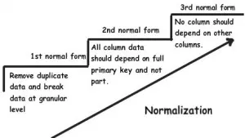
Normalization
Four [main] normal forms used in database normalization:
First Normal Form (1NF)
Contains only automic values
Each record unique and no repeating groups
Second Normal Form (2NF)
It is in 1st normal form
No partial dependencies of any column on primary key
All Non-key attributes functionally dependent on primary key
Third Normal Form (3NF)
It is in 2nd normal form
There is no transitive functional dependency
Boyce-code Normal Form(BCNF)
BCNF Normal form is a higher form of third normal form. This form is used to handle anomolies not handled in the 3rd normal form. BCNF does not allow dependencies between attributes that belong to candidate keys. It drops the restriction of the non key attributes from third normal form.
*A Candidate Key can be any column or a combination of columns that can qualify as unique key in a database. There can be multiple Candidate Keys in one table. Each Candidate Key can qualify as a Primary Key. A Primary Key is a column or a combination of columns that uniquely identify a record.
https://www.complexsql.com/database-normalization/
Notes:
1. First Normal Form/1st Normal Form:
The first normal form is the normal form of database where data must not contain repeating groups.The database is in First normal form If,
1. It contains only automic values.
Automic values:- The Single cell have only single value
2. Each Record needs to be unique and there are no repeating groups.
Repeating Groups:- Repeating group means a table contains 2 or more values of columns that are closely related.
2. Second Normal Form/2nd Normal Form:
The data is said to be in second normalized form If,
1. It is in First normal form
2. There should not be any partial dependency of any column on primary key. Means the tables have a concatenated primary key and each attribute in each table depend on that concatenated primary key.
3. All Non-key attributes are functionally dependent on primary key. If primary is not composite key then all non key attributes are functionally dependent on primary key.
3. Third Normal Form/3rd Normal Form:
The database is in Third normal form if it satisfies following conditions:
1. It is in Second normal form
2. There is no transitive functional dependency
Transitive Dependency:
When table 1 is Functionally dependent on table 2m and table 2 is functionally dependent on table 3, then table 3 is transitively dependent on table 1 via table 2.
Two advantages of 3rd normal form:
1.Amount of data duplication is removed because transitive dependency is removed in third normal form.
2.Achieved Data integrity
4. BCNF(Boyce-Codd Normal Form)
BCNF Normal form is higher version of third normal form. This form is used to handle analomies which are not handled in third normal form. BCNF does not allow dependencies between attributes that belong to candidate keys*. It drops the restriction of the non key attributes from third normal form.
*A Candidate Key can be any column or a combination of columns that can qualify as unique key in database. There can be multiple Candidate Keys in one table. Each Candidate Key can qualify as a Primary Key. A Primary Key is a column or a combination of columns that uniquely identify a record.
Third normal form and BCNF are not the same if following conditions are true:
1. The table has 2 or more candidate keys
2. At least two of the candidate keys are composed of more than 1 attribute
3. The keys are not disjoint.
Example:
Address-> {City,Street,Zip}
Key 1-> {City,Zip}
Key 2->{City,Street}
No non key attribute hence this example is 3NF.
{City,Street}->{zip}
{Zip}->{City}
There is dependency between attributes belonging to key. Hence this is BCNF.

Slide 4
Normalization in ML
In the context of machine learning and data science, normalization takes the values from the database and where they are numeric columns, changes them into a common scale.
For example, imagine you have a table with two columns and one contains values between 0 and 1 and the other contains values between 10,000 and 100,000.
The huge differences in scale might cause problems if you attempt to do any analytics or modelling.
Data normalization creates a matching scale across all columns while maintaining the distribution e.g. 10,000 might become 0 and 100,000 becomes 1 with values in-between being weighted proportionality.​
Consider a dataset of credit card information which has two variables, One for the number of credit cards and the second for income
Using these attributes, you might want to create a cluster and find similar applicants.
Both of these variables will be on completely different types of scale (income being much higher) and would therefore likely have a far greater influence on any results or analytics. Normalization removes the risk of this kind of bias.​

Slide 5
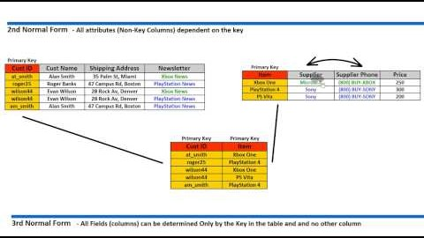
Normalization Demo

Slide 6
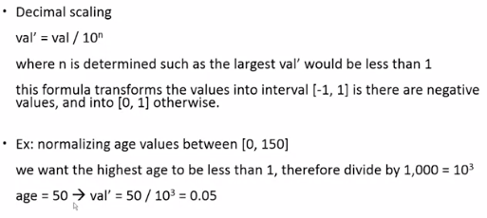
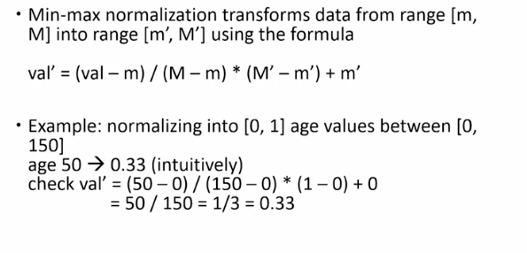
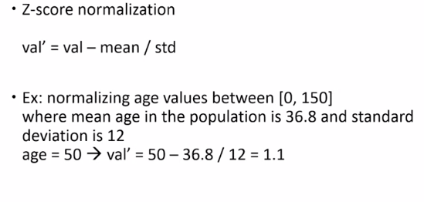
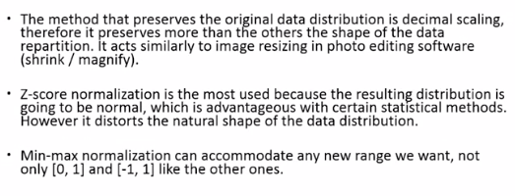
Normalization
Decimal Scaling
Min-Max Normalization
Z-Score Normalization
Method Comparison

Slide 7
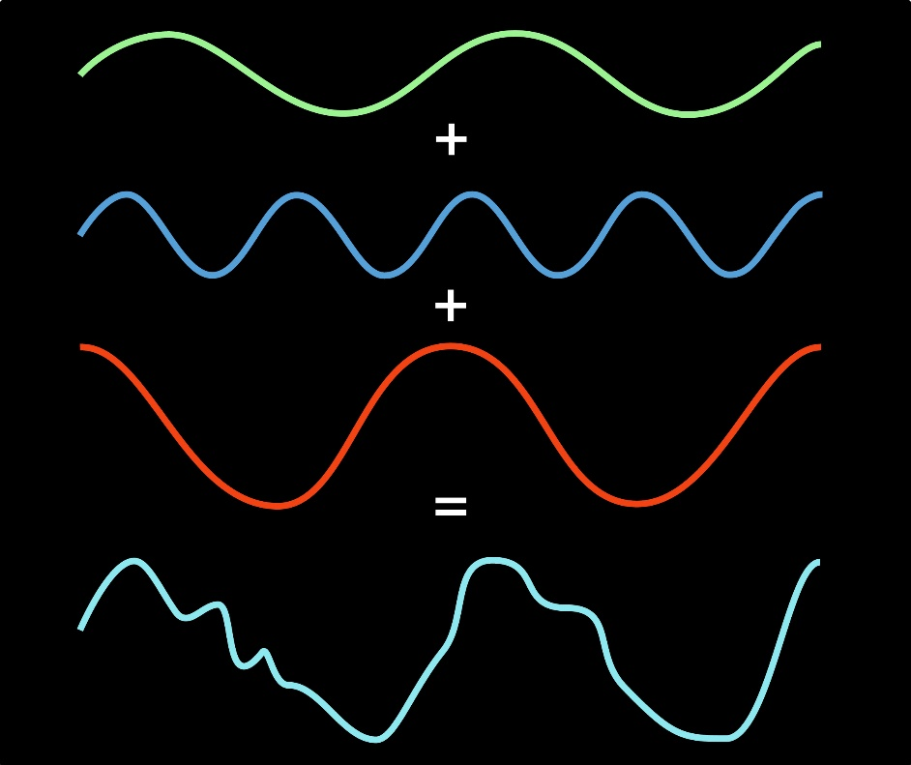
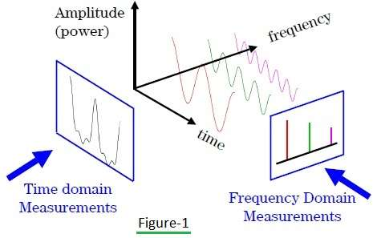
Fast Fourier Transforms
The fast Fourier transform is a mathematical method for transforming a function of time into a function of frequency. Sometimes it is described as transforming from the time domain to the frequency domain. It is very useful for analysis of time-dependent phenomena.
The Fourier Transform takes a time-based pattern, measures every possible cycle, and returns the overall "cycle recipe" (the amplitude, offset, & rotation speed for every cycle that was found).

Slide 8
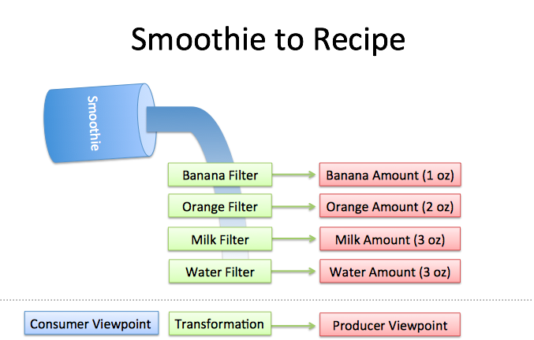
Fast Fourier Transforms
Example: given a smoothie, let's find the recipe.
You wouldn't share a drop-by-drop analysis, you'd say "I had an orange/banana smoothie". A recipe is more easily categorized, compared, and modified than the object itself.
So... given a smoothie, how do we find the recipe?
We can reverse-engineer the recipe by filtering each ingredient. The catch?
Filters must be independent. The banana filter needs to capture bananas, and nothing else. Adding more oranges should never affect the banana reading.
Filters must be complete. We won't get the real recipe if we leave out a filter ("There were mangoes too!"). Our collection of filters must catch every possible ingredient.
Ingredients must be combine-able. Smoothies can be separated and re-combined without issue (A cookie? Not so much. Who wants crumbs?). The ingredients, when separated and combined in any order, must make the same result.

Slide 9
Discrete Wavelet Transforms
The discrete wavelet transform has a huge number of applications in science, engineering, mathematics and computer science. Most notably, it is used for signal coding, to represent a discrete signal in a more redundant form, often as a preconditioning for data compression.
Application: The wavelet transform is a mathematical tool that decomposes a signal into a representation that shows signal details and trends as a function of time.
When a signal is deconstructed into wavelets rather than sin() and cos() it is called a Wavelet Transform.
You can use this representation to characterize transient events, reduce noise, compress data, and perform many other operations.
Wavelets are useful because they are limited in time and frequency.
Decomposing a signal into wavelets rather than frequencies can give much better resolution in the domain it is transformed into. However when a Wavelet Transform is used, the signal is transformed into the wavelet domain, rather than the frequency domain.

Slide 10
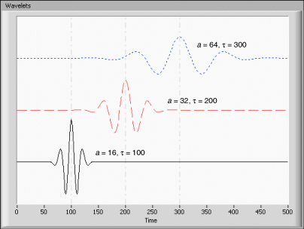

Discrete Wavelet Transforms
Same wavelet at different scales
A wavelet is a ‘mini wave’ while sin() and cos() are infinite (they never go to zero and stay there, they carry on forever).
During the Fourier Transform the signal is deconstructed into infinitely long waves
If you have a high resolution in the frequency domain (i.e. focusing on one frequency, like sin(3x) ) it is hard to isolate it in time, as each frequency exists across all time.
Being uncertain of the time when focusing on the frequency is the flip-side of being uncertain of the frequency when focusing on time.
To overcome this resolution problem a Wavelet Transform is used to deconstruct the signal into a load of wavelets being added together. Wavelets are useful because they are limited in time and frequency.
Wavelet Transform deconstructs the signal using the same wavelet at different scales,
100’s of different wavelets = 100’s of different transforms and therefore hundreds of different domains.
Each domain has ‘scale’ on the x-axis rather than ‘frequency’, which provides better resolution in the limited the time domain
‘denoised’ using wavelets
https://georgemdallas.wordpress.com/2014/05/14/wavelets-4-dummies-signal-processing-fourier-transforms-and-heisenberg/

Slide 11
Coordinate Transformations for geometric data defined over Euclidean
Because there are often many different possible coordinate systems for describing geometrical figures, it is important to understand how they are related.
Such relations are described by coordinate transformations which give formulas for the coordinates in one system in terms of the coordinates in another system.
For example, in the plane, if Cartesian coordinates (x, y) and polar coordinates (r, θ) have the same origin, and the polar axis is the positive x axis, then the coordinate transformation from polar to Cartesian coordinates is given by x = r cosθ and y = r sinθ.
With every bijection* from the space to itself two coordinate transformations can be associated:
such that the new coordinates of the image of each point are the same as the old coordinates of the original point (the formulas for the mapping are the inverse of those for the coordinate transformation)
such that the old coordinates of the image of each point are the same as the new coordinates of the original point (the formulas for the mapping are the same as those for the coordinate transformation)
For example, in 1 dimension, if the mapping is a translation of 3 to the right, the first moves the origin from 0 to 3, so that the coordinate of each point becomes 3 less, while the second moves the origin from 0 to −3, so that the coordinate of each point becomes 3 more.
*Bijection, bijective function, or one-to-one correspondence is a function between the elements of two sets where each element of one set is paired with exactly one element of the other set, and each element of the other set is paired with exactly one element of the first set and there are no unpaired elements.

Slide 12
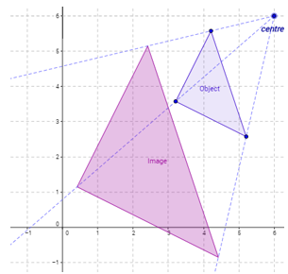
Coordinate Transformations for geometric data defined over Euclidean
In geometric transformation the object itself is moved relative to a stationary coordinate system or background on the other hand in coordinate transformation the object is held stationary while the coordinate system is moved relative to the object.
Rescale
4 types of transformations
Translation
Rotation
Reflection

